Slide 1
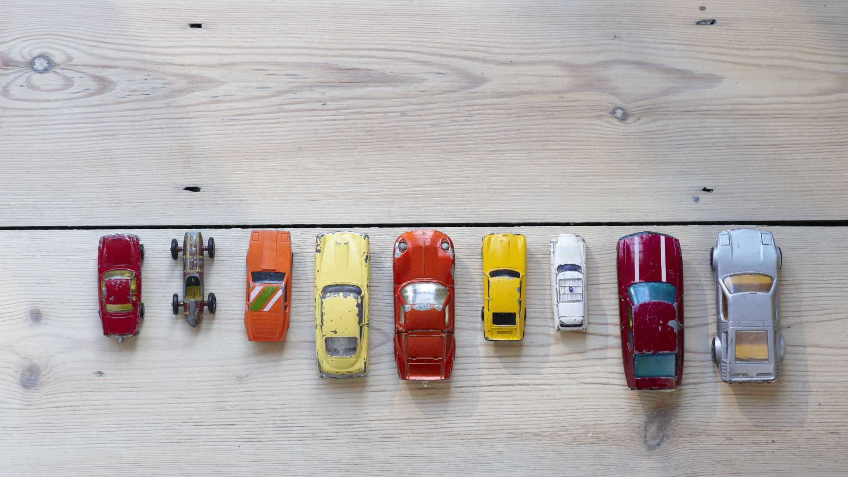
Budget and Environmentally Friendly Car Recommendation System
Sundus Yawar
Notes:
REMEMBER TO SELECT LASER POINTER
Ctrl +L

Slide 2



Non-Technical Overview & Potential Impact
- Opens doors to making environmentally responsible decision within a tight budget given the increased cost of living
- environmentally friendly i.e. fuel efficient, low CO2 emissions, best smog rating
- cost efficient i.e. within budget for purchase & fuel efficiency
Notes:
As you are aware that hybrid and electric vehicles are very expensive and not everyone can afford to buy these yet we still have to fulfill our responsibility towards the environment.
To address this issue I decided to use machine learning to categorize fuel powered vehicles as green or not green and build a recommendation system to recommend green vehicles to users based on their budget.
=========================================================================================================================================
Not everyone can afford hybrid and electric vehicles. So this reccommendar system helps people make environmentally responsible choices even within a tight budget as it recommends green vehicles based on their budget.
Cost of living has increased substantially but salaries remain the same, last summer gas prices went up till 217 cents/Litre and this summer they went from 145 cents/Litre to 172 cents/Litre
Helping users find a car that is both within their budget, is environmentally friendly and cost efficient in terms of fuel can help everyone make an environmentally responsible choice while staying within their budget

Slide 3

Proposed Vision for Tackling the Problem
The data isn’t labeled for whether the cars in the dataset are green or not. However, it has sufficient information for an unsupervised learning model to detect similarities and cluster similar items together, which can help label the data
Unsupervised Machine Learning Technique to cluster the data for best and worst CO2 rating, Smog rating, Combined fuel consumption rating by Make and Vehicle class
Then will explore the data and label the clusters
Build a website that will allow users to select budget range and vehicle class they are interested in and since the data is labeled now thanks to unsupervised machine learning technique (clustering), it will just filter the data based on user input and recommend greener option within budget selected and vehicle class chosen

Slide 4
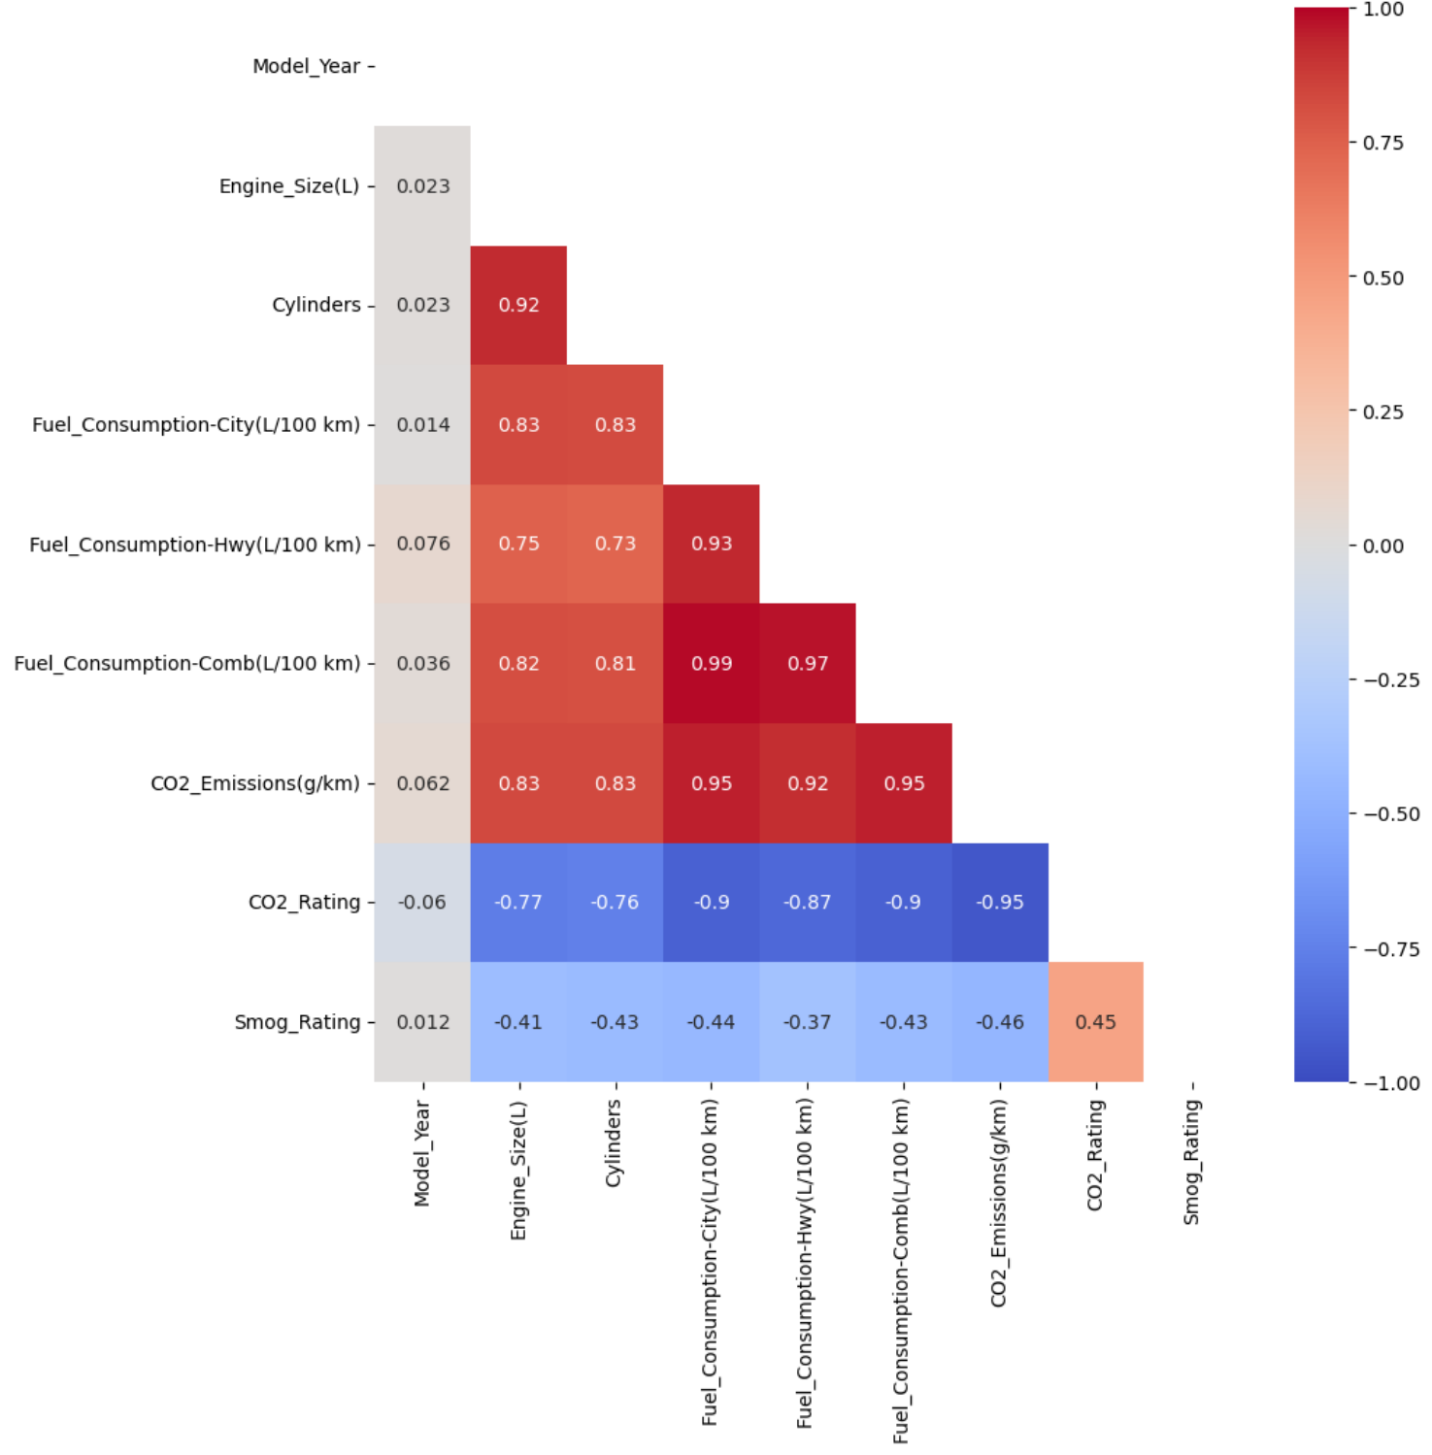
Overview of the Dataset & Preprocessing Procedures
6,951 rows and 8 columns; 19 columns after 1 hot encoding
Model_Year | Make | Model | Vehicle_Class | Fuel_Type | Fuel_Consumption-Comb(L/100 km) | CO2_Emissions(g/km) | Smog_Rating
Vehicle_Class | Fuel_Consumption-Comb(L/100 km) | CO2_Emissions(g/km) | Smog_Rating
- Prices data was brought in from other datasets, some of them included Price by Make, Model, Year and Mileage so I grouped by the 3 columns and took average then joined the grouped data with the main dataset. 1 of them required currency conversion.
- Found data quality issues in the prices dataset where prices for cars were in 100s and the mileage wasn’t even > 10,000. The cars in the dataset were from 2017-2020.
- Chi2 test (Model & Vehicle Class)
- Domain Knowledge & Correlation Matrix
- VIF Analysis for multicollinear columns

Slide 5
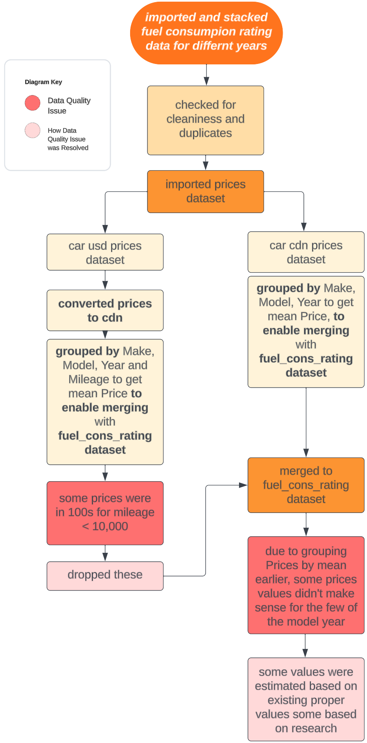
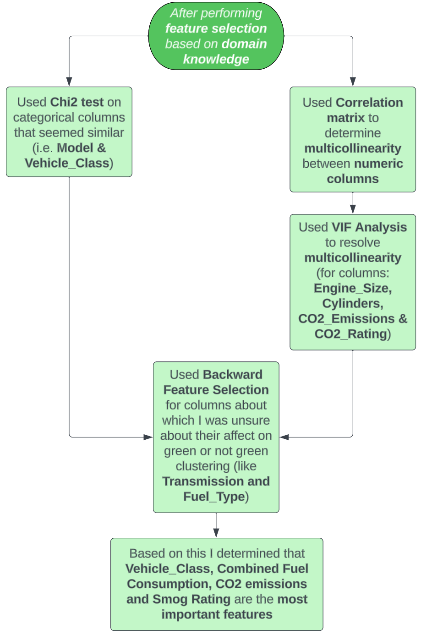
Overview of the Dataset & Preprocessing Procedures
Dataset Originally consisted of 6,951 rows and 15 columns
Some of the important features include:
Model_Yeal
Make
Model
Vehicle_Class
Fuel_Type
Fuel_Consumption-Comb(L/100km)
CO2_Emissions
Smog Rating
scale 1 – 10 where
1 means worst
10 means best
Notes:
Initially I had 6.9k rows and 18 columns, and these are just a few of the columns I was initially considering for modelling.
In order to build this system I had to do extensive preprocessing and feature selection.
The 1st flow chart shows some of the preprocessing steps I took, data quality issues I encountered and how I resolved them.
The 2nd flow chart shows the feature selection procedure I went through like statistical analysis and backward feature selection and the features you see in green color are the ones I found to be most relevant for modelling through this process.
=========================================================================================================================================
This flow chart talks about some of the preprocessing steps I had to take, data quality issues encountered and how I resolved them.
Dataset Originally consisted of 6.9k rows and 15 columns
On the right, you can see some of the important features in the dataset like Make, Model, Vehicle Class, combined fuel consumption co2 emissions and smog rating
I selected the features based on domain knowledge, chi 2 test, correlation matrix and VIF analysis for multicollinearity between numeric columns and finally backward feature selection
============================================================
Fuel consumption rating data was in several files so I had stack dataframes after importing.
I also had 2 different datasets for prices and had to merge their prices by mean and grouping them by Model, Make and Year.
Data quality issues I encountered
- In the first dataset some prices for cars did not make sense as they were in 100s so I had to drop them
- Second dataset didn’t have any issues
- however after merging the prices data I noticed that some vehicles were overpriced for their model’s years so I looked into those and fixed them
Talk about feature selection

Slide 6
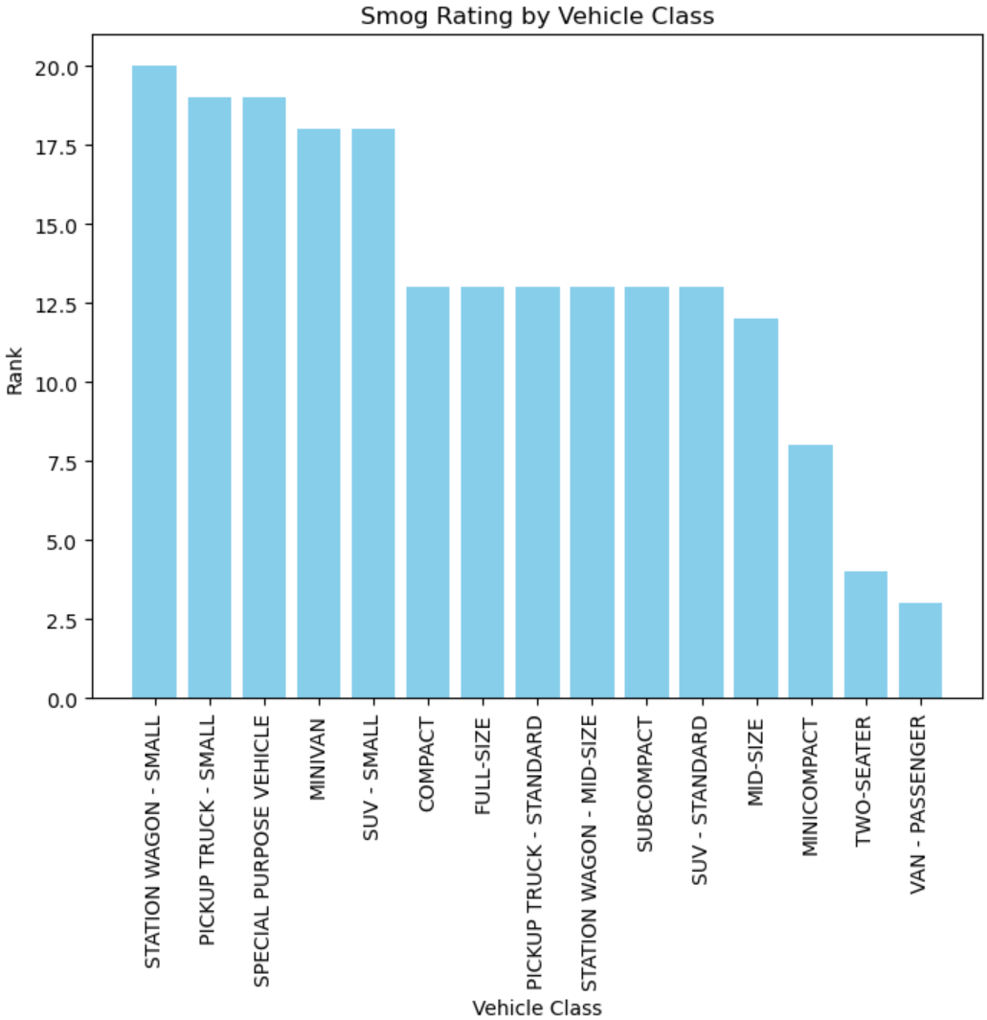
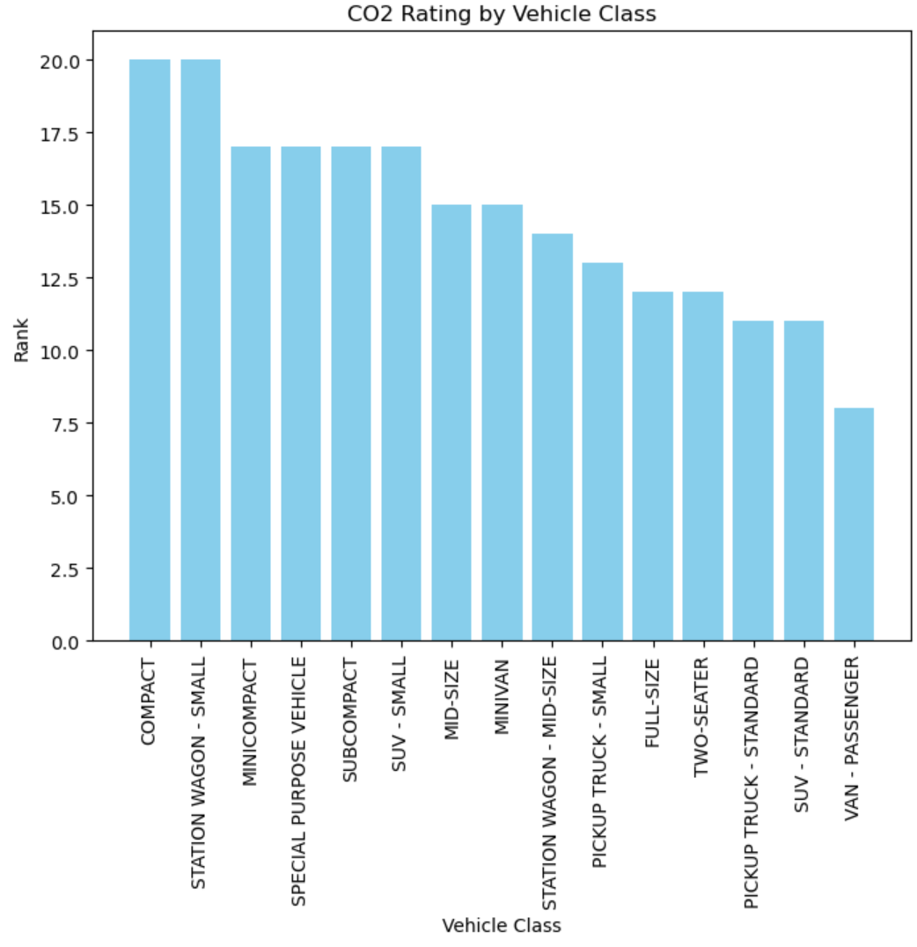
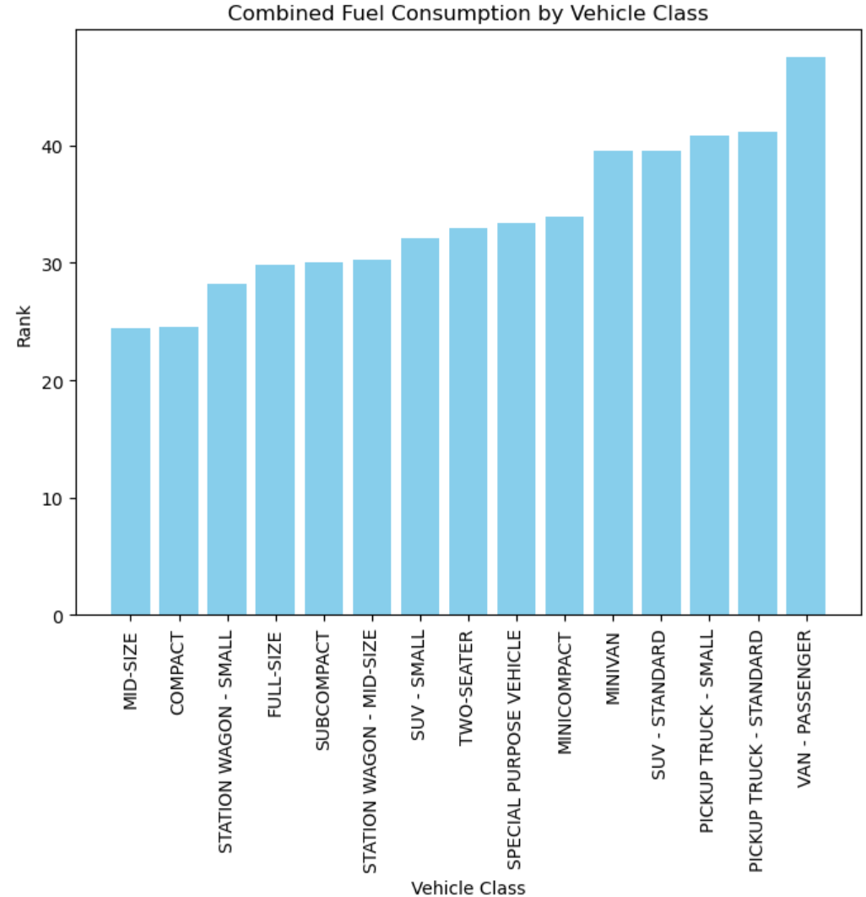
Few Important Findings from EDA
Notes:
Rating are 1-10 10 being the best hence in descending order, for fuel consumption in ascending order cux lower means best here.
Weighted score was calculated to rank these.
- for Smog & CO2 Ratings it was calculated based on:
- median, 75% and IQR
- 2, 2, 3
- for fuel cons it was calculated based on
- median, 25% and IQR
- 2, 2, 3

Slide 7
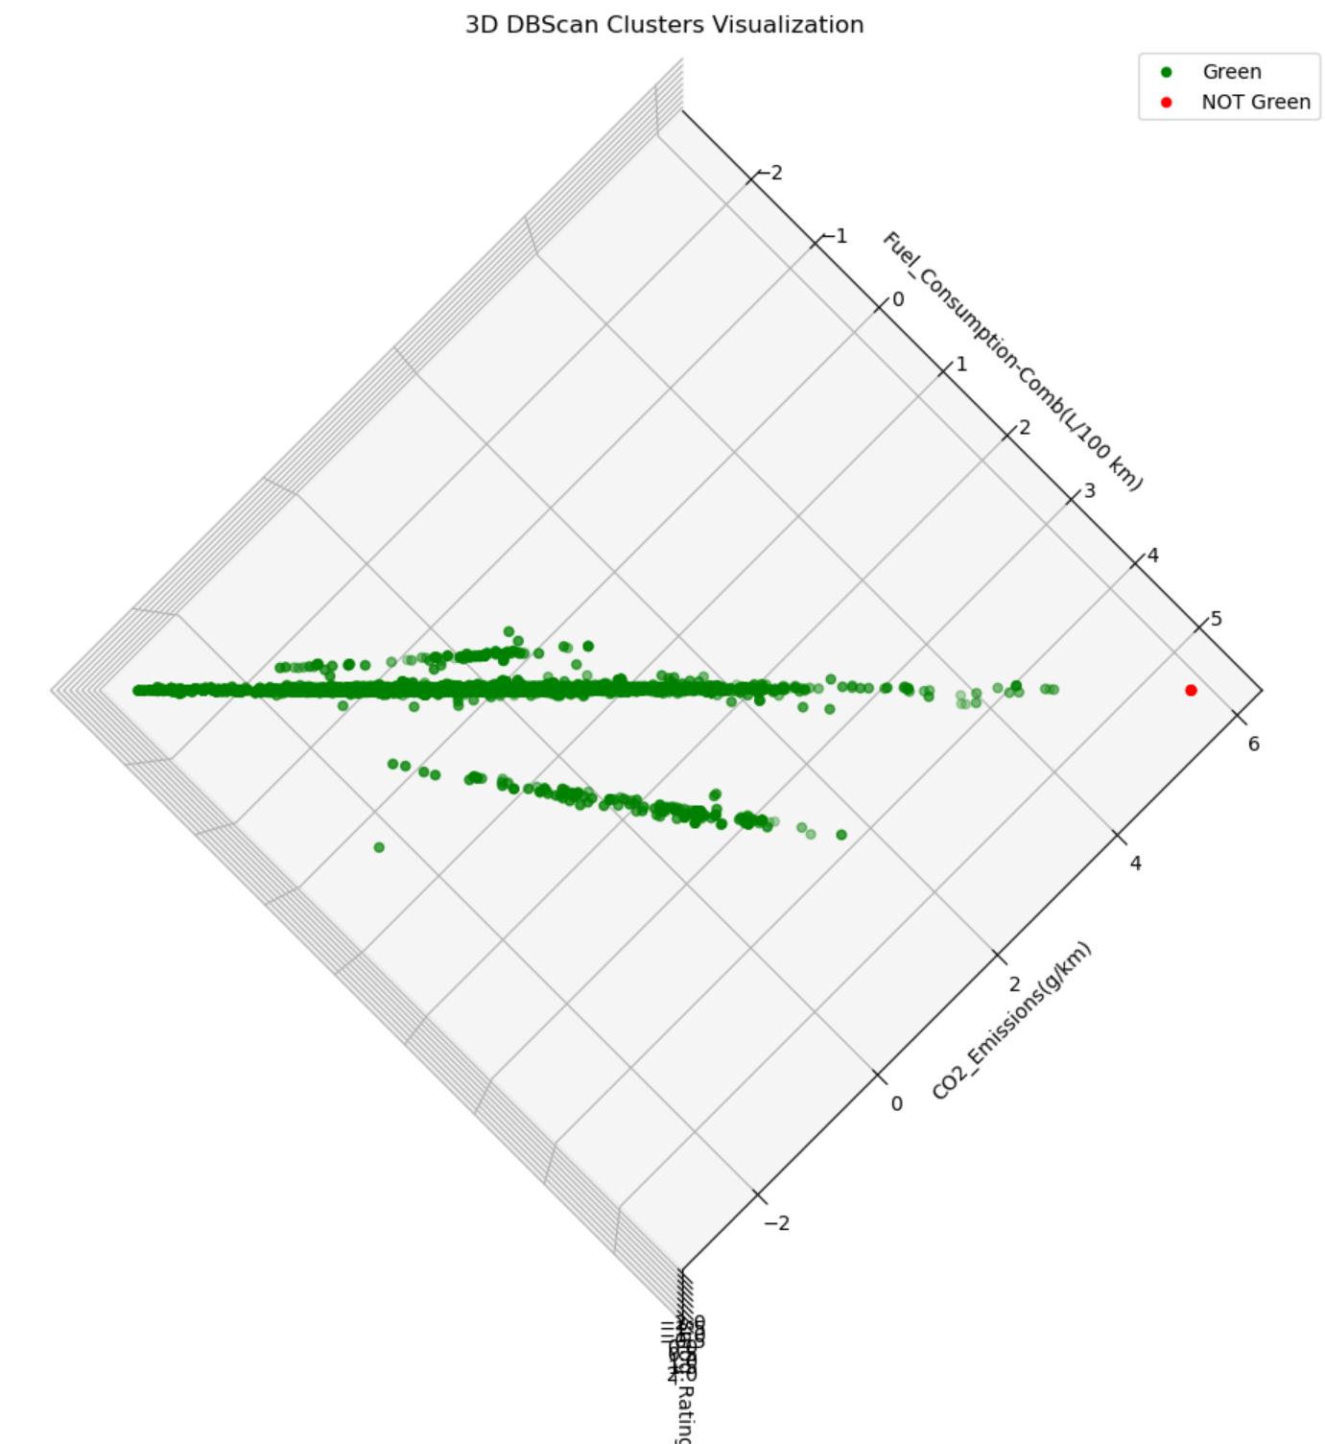
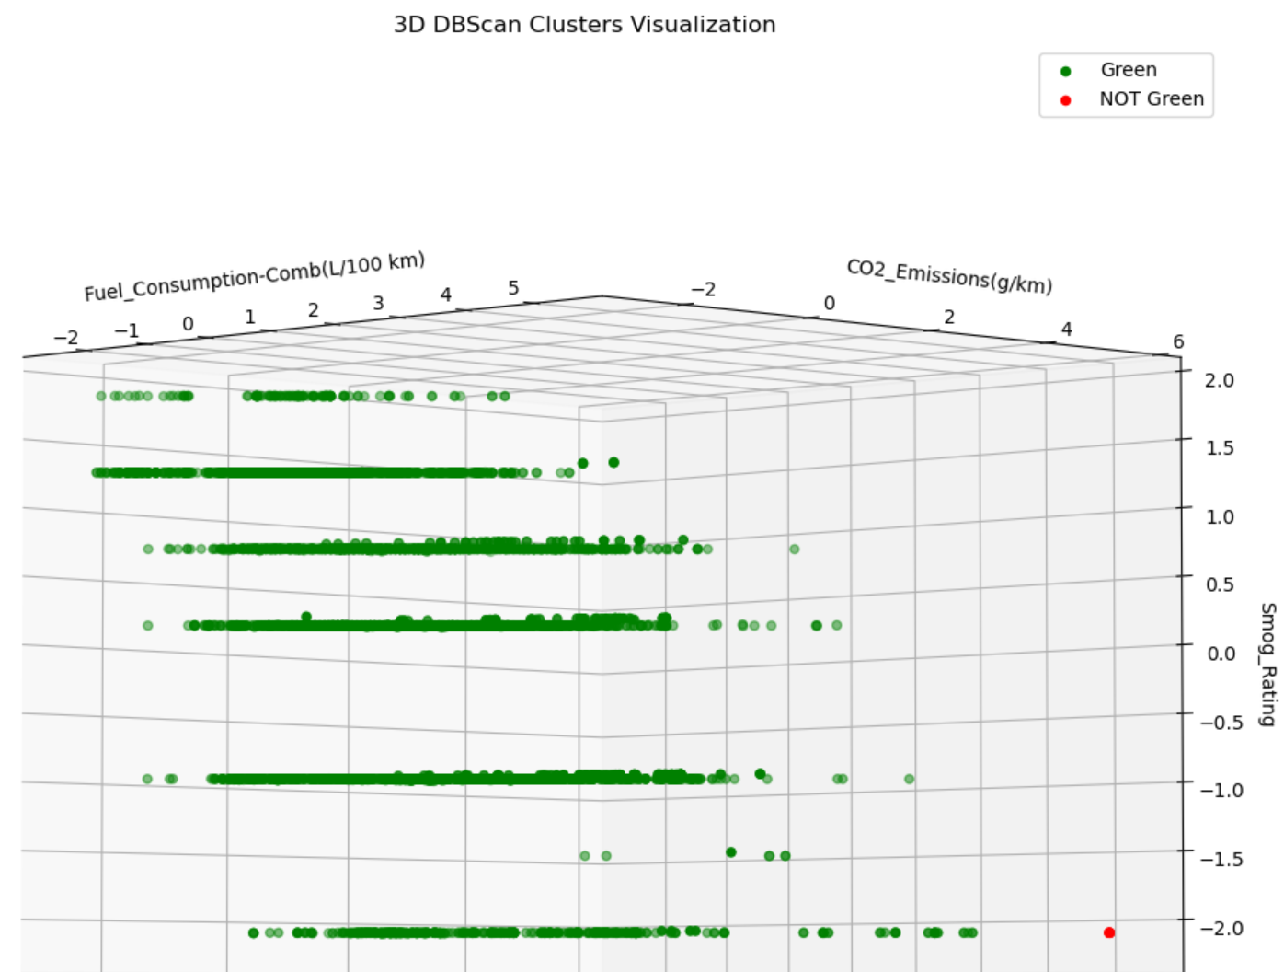
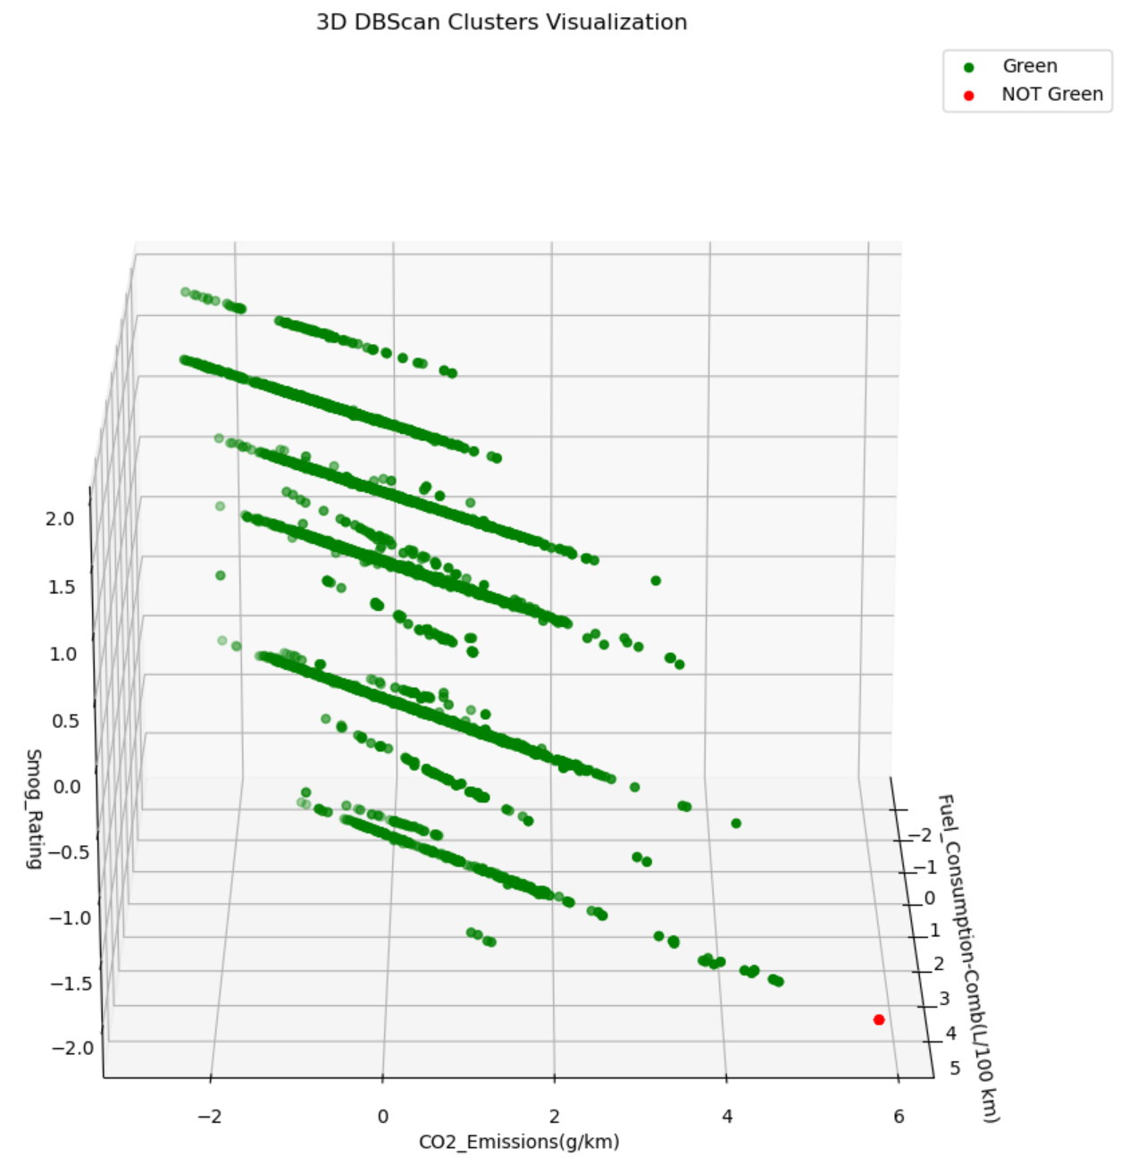
Model Comparison & Interpretations
Cluster labels | Median of Fuel_Consumption_Comb (L/100km) | Median of CO2_Emissions(g/km) | Median of Smog Rating
Green Vehicle | -0.132738 →low | -0.074922 →low | 0.139051 →high
NOT Green Vehicle | 5.406509 →high | 5.800374 →high | -2.09703 →low
Best | KMeans | DBScan | DBScan_v2
# of features | 18 after 1 hot encoding | 18 after 1 hot encoding | 3
Clusters formed | 420 | 2 | 2
Silhouette Score | 0.60303 | 0.5395 | 0.72877
Notes:
- silhouette score is a performance metrics to determine efficiency of the clusters formed by the model
- As u can see Kmeans is only able to perform well with 420 clusters which isn’t practical as the objective is to determine green vehicles from non green ones. While initially that made sense as these 3 features varied by vehicle classes.
- Seeing 2 clusters from DBScan gave me the idea that perhaps it really all just boils down to 3 features.
Those 3 features are:
- Combined fuel consumption
- CO2 emissions
- Smog Rating
- So I tried again with just these 3 features and was able to yield silhouette score of 0.73 out of 1 which shows higher performance.
NEXT ARROW KEY
- Now does this clustering makes sense? Well a green vehicle is a vehicle with low Fuel Consumption and co2 emissions and high smog rating. Recall that smog rating was on a scale of 1-10 where 10 meant best, u see a diff scale here as I applied standard scalar for modeling.
- And as u can see here the red cluster lies in the area with high fuel consumption and co2 emissions and low smog rating
- Also u may be wondering why some of the green vehicles lie below 0 for smog rating, shouldn’t they be part of red cluster?
- well it is because most of these still lie in the lower ranges of fuel consumption and co2 emissions and based on my experiments it seems that these 2 features have higher feature importance compared to smog rating.
- Now you may be wondering why there are more green vehicles than non-green vehicles. That’s actually due to imbalance in the dataset I was working with.
- And u may also be wondering why vehicles in the green cluster below 0 for smog rating aren’t part of the red cluster i.e. the non green vehicles.
- USED NEXT ARROW KEY
- I was wondering the same and tried remodeling using dbscan again, and noticed that while this model does classify vehicles below 0 for smog rating as not green if I look at the bird’s eye view of the clusters most of these red clusters lie within green range i.e. low fuel consumption and co2 emissions
- which tells me that fuel consumption and co2 emissions have higher feature importance compared to smog rating
- and as u can tell this model has a much lower score compared to othe one I showed u earlier
=========================================================================================================================================
- cluster separation is very clear from all angles
- So what does it mean by a green vehicle? Green vehicle is a vehicle with low fuel consumption and co2 emissions and high smog rating
=========================================================================================================================================
Combined Fuel consumption range: 4 – 26
CO2 emissions range--------------→ 94-608
Smog rating-----------------------→ 1 - 10

Slide 8
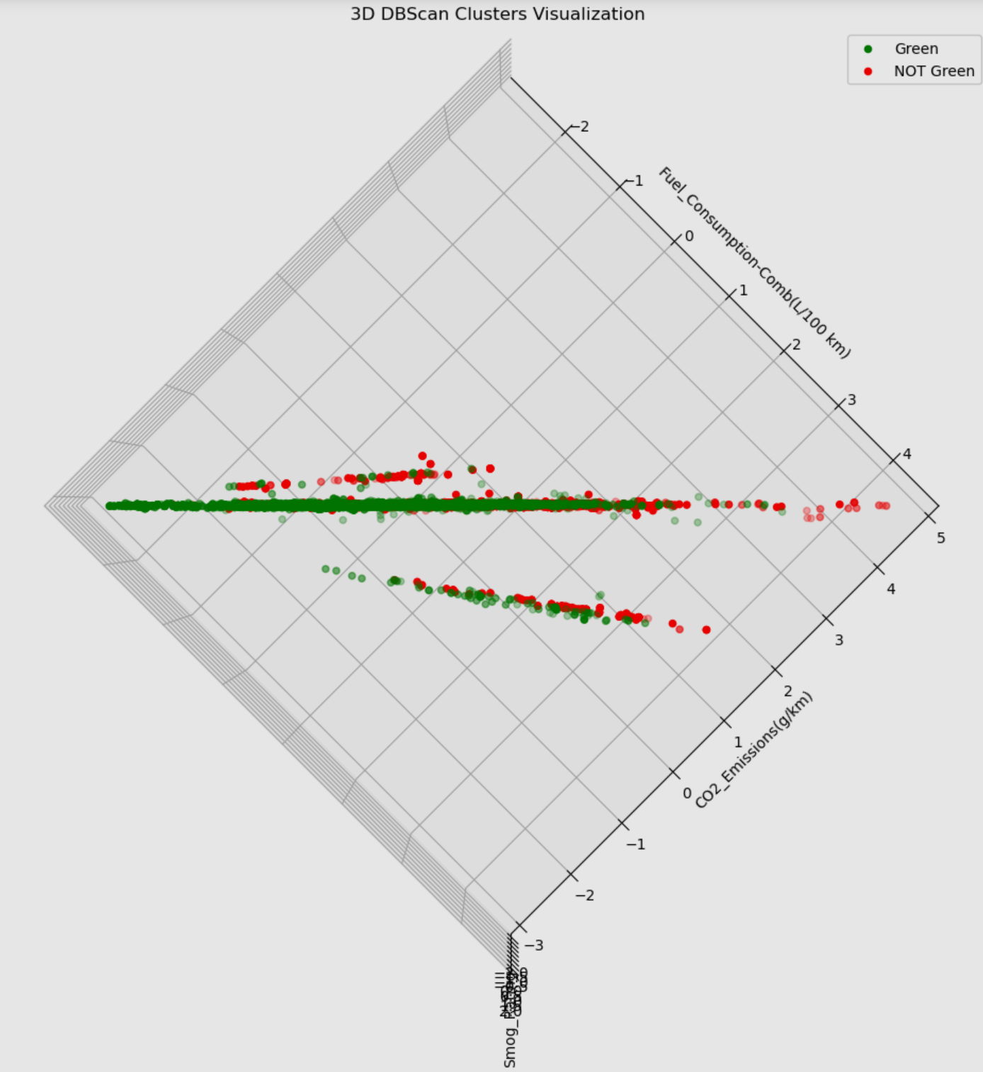
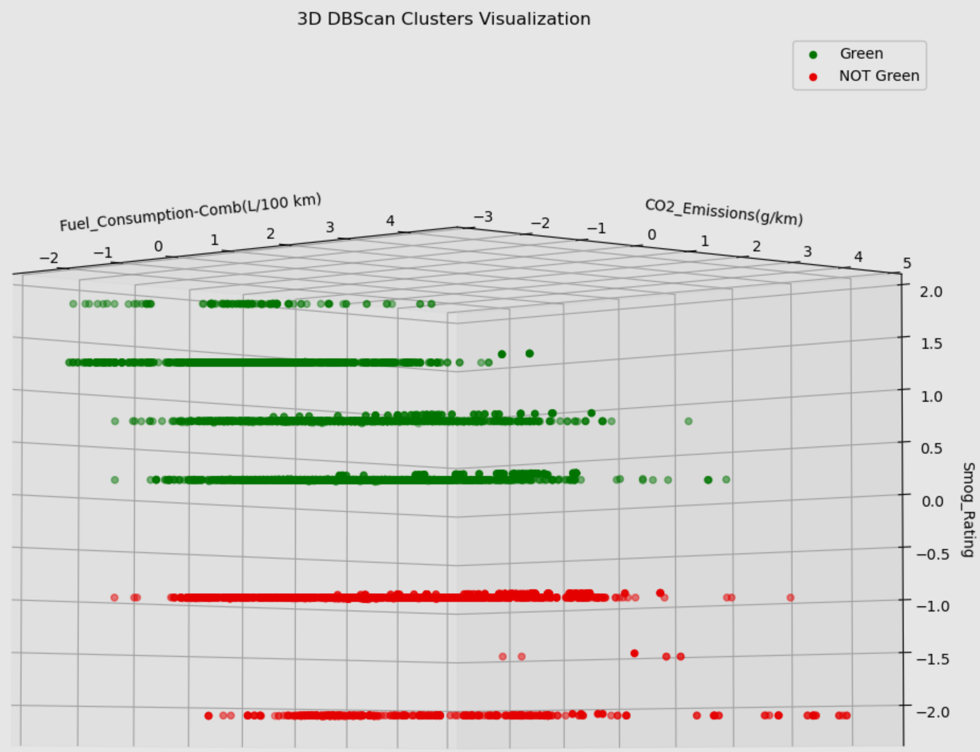
Model Comparison & Interpretations
Best | KMeans | DBScan | DBScan_v2
# of features | 18 after 1 hot encoding | 18 after 1 hot encoding | 3
Clusters formed | 420 | 2 | 2
Silhouette Score | 0.60303 | 0.5395 | 0.72877
DBScan Model Silhouette Score: 0.36285
DBScan Model Silhouette Score: 0.36285
Notes:
- silhouette score is a performance metrics to determine efficiency of the clusters formed by the model
- As u can see DBScan is only able to perform well with 420 clusters which isn’t practical as the objective is to determine green vehicles from non green ones. While initially that made sense as these 3 features varied by vehicle classes.
- Seeing 2 clusters from DBScan gave me the idea that perhaps it really all just boils down to 3 features.
Those 3 features are:
- Combined fuel consumption
- CO2 emissions
- Smog Rating
- So I tried again with just these 3 features and was able to yield silhouette score of 0.73 out of 1 which shows high performance.
- So how do we know if this clustering makes sense? Well a green vehicle is a vehicle with low Fuel Consumption and co2 emissions and high smog rating. Recall that smog rating was on a scale of 1-10 where 10 meant best, u see a diff scale here as I applied standard scalar for modeling.
- And as u can see here the red cluster lies in the area with high fuel consumption and co2 emissions and low smog rating
- Also u may be wondering why some of the green vehicles lie below 0 for smog rating, shouldn’t they be part of red cluster?
- well it is because most of these still lie in the lower ranges of fuel consumption and co2 emissions and based on my experiments it seems that these 2 features have higher feature importance compared to smog rating.
- Now you may be wondering why there are more green vehicles than non-green vehicles. That’s actually due to imbalance in the dataset I was working with.
- And u may also be wondering why vehicles in the green cluster below 0 for smog rating aren’t part of the red cluster i.e. the non green vehicles.
- USED NEXT ARROW KEY
- I was wondering the same and tried remodeling using dbscan again, and noticed that while this model does classify vehicles below 0 for smog rating as not green if I look at the bird’s eye view of the clusters most of these red clusters lie within green range i.e. low fuel consumption and co2 emissions
- which tells me that fuel consumption and co2 emissions have higher feature importance compared to smog rating
- and as u can tell this model has a much lower score compared to othe one I showed u earlier
=========================================================================================================================================
- cluster separation is very clear from all angles
- So what does it mean by a green vehicle? Green vehicle is a vehicle with low fuel consumption and co2 emissions and high smog rating

Slide 9
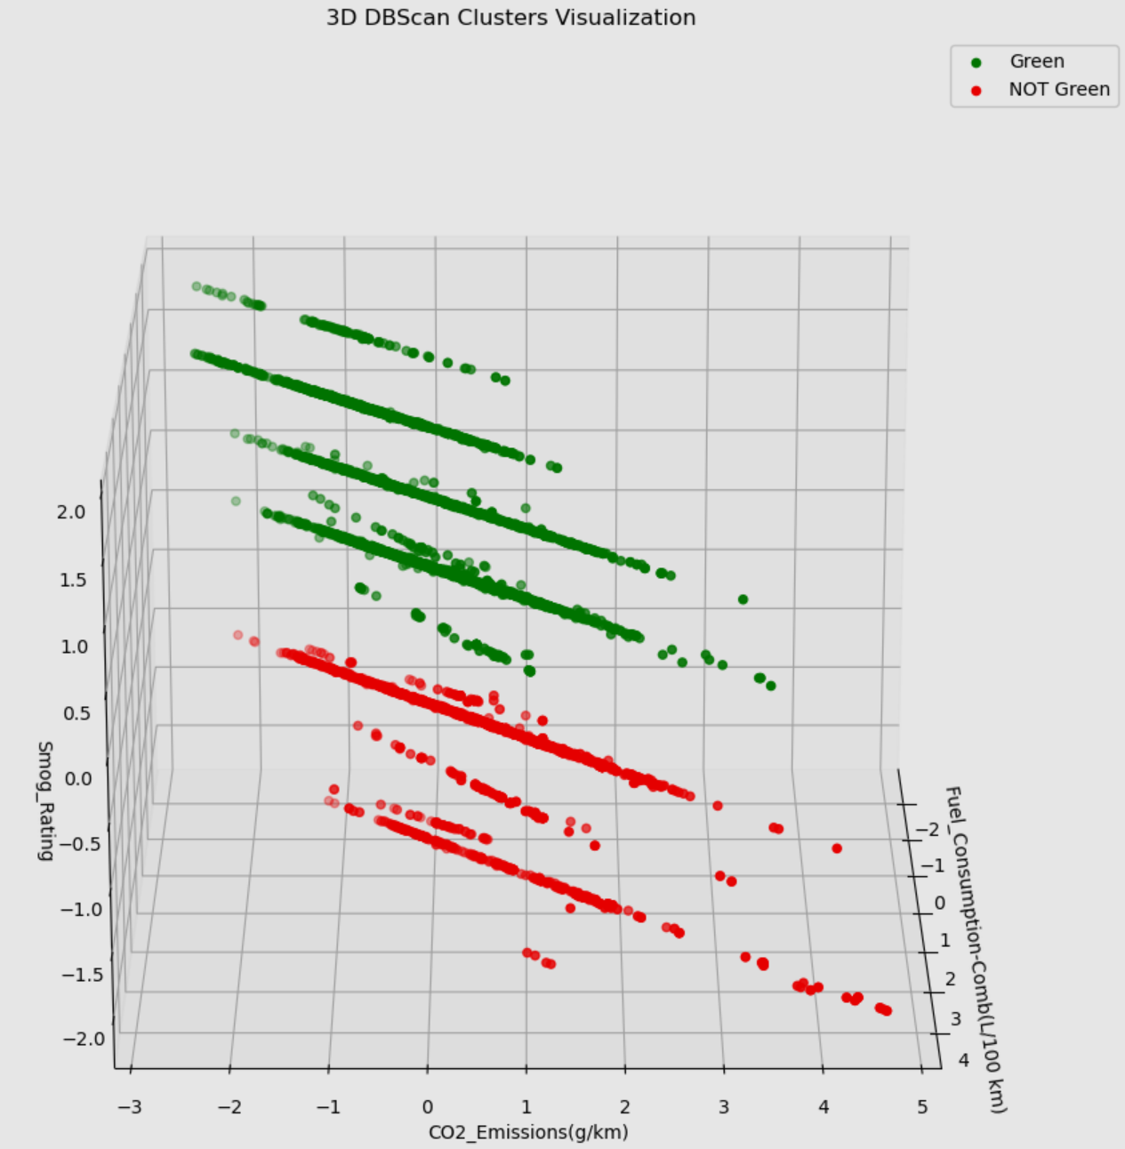
Model Comparison & Interpretations
DBScan Model Silhouette Score: 0.72877
DBScan Model Silhouette Score: 0.36285
Notes:
- Model visualization with white background are of DBScan model with silhouette score of 0.72877
- Model visualization with grey background are of DBScan model with silhouette score of 0.36285
- As you can see the model at the bottom did cluster with almost an equal separation however, if you see the bird’s eye images most of the red clusters lies in the greener segment because they have both fuel consumption and co2 emissions values low, mainly
- this tells me 2 things:
- that Fuel consumption and CO2 emissions have a higher feature importance compared to smog rating for determining whether the vehicles are green or not green

Slide 10
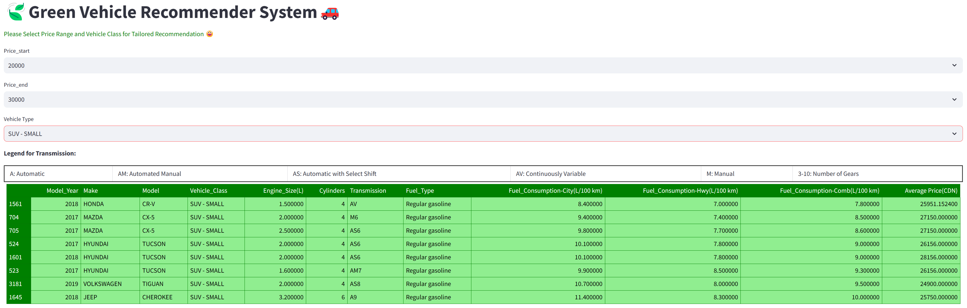
Demo
Demo Link: https://green-vehicle-recommender-system.streamlit.app/
- Allows users to easily select fuel based green vehicle based on their budget and vehicle type they are interested in.
- The results are sorted by Combined Fuel Consumption allowing users to see which of the green vehicles have better fuel efficiency
Notes:
Finally I am able to make a recommender system that recommends green vehicles to users based on their budget allowing them to be environmentally responsible.

Slide 11



Thank You!

